Slide 1

Department of Computer Science and Engineering CSB4243 – DESIGN PROJECT 1 TABLE TENNIS USING HAND GESTURE Review-1
Dani N 21113004
Dharshan R E 21113049
SUPERVISORS
Dr.R. Krishnaveni, Professor
Dr.S. Sathyalakshmi, Professor

Slide 2
Agenda for Review 1
Abstract
Introduction
Goals and Motivation
Literature review/Existing Systems
Problem Definition
Objective
Proposed System/Work
Architecture Diagram
Contribution of Team members
References

Slide 3
Abstract
Problem: Traditional gaming controllers have limitations and lack natural, intuitive ways to interact with games.
The limitation of using hand gestures for table tennis is accuracy and precision, and the problem that we want to solve is to improve it, making the sport more accessible and inclusive, promoting physical activity, social interaction, and innovation in technology.
Proposed solution: Use hand tracking technology and AI to detect hand landmarks and control game inputs, providing a more natural and intuitive way to interact with games.
Methods/Components: AI, computer vision technology, and hardware setup with cameras to detect hand movements and landmarks.
Justification: The use of AI, computer vision technology is to justify their ability to create and improve accuracy and player will able to play the game with bot or with competitive player.

Slide 4
Introduction
Welcome to our design project, Table Tennis using Hand Gesture. Our project aims to create a fun and interactive game using hand gesture recognition technology. The game uses a webcam to track the user's hands and allows the user to control the movement of the rackets on the screen using their hand gestures. The goal of the game is to prevent the ball from passing the user's racket. Our proposed system utilizes the OpenCV library for image processing and the cvzone library for hand tracking. Our project aims to provide an innovative and immersive gaming experience for the users.

Slide 5
Goals and Motivation
Goals:
To revolutionize the gaming experience by integrating hand gesture recognition technology into a Table Tennis game.
The ultimate goal of this project is to showcase the capabilities of hand gesture recognition technology in the field of gaming and its potential to create new and exciting gaming experiences.
And to provide an immersive gaming experience for the users.
Motivation:
The inspiration behind this project is the increasing interest in hand gesture recognition technology and its potential to bring a new level of interactivity to the gaming industry.
The project's aspiration is to provide a fun and unique way for users to interact with the game by using their hand movements, making the game more intuitive and engaging.

Slide 6
Literature review/Existing Systems
S.No | Title of the paper/System | Authors | Publication (Name of the Journal/Conference proceedings with Year) | Algorithm/Methodology adopted | Limitations
1. | Machine Learning With The Pong Game | Doina ,Logofătu | 21st International Conference on Computational Science and Applications(ICCSA),2021 | Q-learning is reinforcement learning algorithm where an agent learns to make decisions. Algorithm:Q-Learning | Accuracy:44.6% The Q-values requires more data
2. | Machine Vision-Based Ping Pong Ball Rotation Trajectory | Yilei, Wang & Ling, Wang | Journal of Computational Intelligence and Neuroscience,2022 | CNN also known as convnets used for image processing and object detection Convolutional neural network(CNN) | Accuracy:40.6% clarity of the captured video is not high enough, and the noise is high enough to make it indistinguishable

Slide 7
Literature review/Existing Systems
S.No | Title of the paper/System | Authors | Publication (Name of the Journal/Conference proceedings with Year) | Algorithm/Methodology adopted | Limitations
3. | Pong Game using AI | Akash ,R., Ruchika ,P .,& Ashish ,P.K | International Journal of Scientific and Research Publications,2022 | Q-learning is reinforcement learning algorithm where an agent learns to make decisions. The algorithm takes on both paddles using ai or bot Algorithm:Q-Learning | Lack of adaptability in different environment Accuracy:64.7 %
4. | Design of Game Pong using VHDL | Sudhanshu M.M., Nakul.N., | International Journal of Engineering Research & Technology (IJERT),2022 | Control the paddles is done without clicking repeatedly Algorithm:State Machine Algorithm | It will work only in the platform of windows Accuracy-50.4

Slide 8
Literature review/Existing Systems
S.No | Title of the paper/System | Authors | Publication (Name of the Journal/Conference proceedings with Year) | Algorithm/Methodology adopted | Limitations
5. | FGPA Implementation of Pong Game | Shith,T.H., Huang, Y.T., Tsai, J.T., | Federated Conference on Computer Science and Information Systems, 2022 | Difficulty modes are available like easy, medium and hard Algorithm:Finite State Machine | Connected only via VGA cable monitor Limited resources such as on-chip, memory, power consumption Accuracy:50.2%

Slide 9
Problem Definition
Lack of natural and intuitive control for this player
Difficulty in executing precise shots, such as spins and serves.
Limitations in replicating the physical movements of a real table
tennis player.
Inaccurate representation of player’s intent and skill level.
Decreased player engagement and enjoyment
Potential hindrance to the growth and development of the game
Lack of access to coaching and guidance for learning table tennis
Difficulty in finding a coach or someone experienced to play with
The need for software that can perform the job of a coach and provide recommendations for improvement

Slide 10
Objective
Controls the bats on the screen using hand gesture in multiplayer
Hit the ball back using computer-controlled AI bat in one side
Compete against the computer AI to achieve the highest score.
Aim to score points by strategically hitting the ball past the computer’s bat and onto the other side of the screen.
Direction of the ball depends on our hand movement

Slide 11
Proposed System/Work
In this project, we are going to create a Table Tennis game.
Detect and track hand movements using a camera or sensor.
Convert the hand gesture into specific commands for the game(e.g., move paddles racket up or down).
Transmit the commands to the game engine.
Update the game state based on the commands received.
Continuously monitor hand gesture and update the game accordingly.
Display the updated game state on the screen.
The system would involve machine learning techniques to recognize different hand gesture and map them to specific commands for the game. The system would also require a robust camera or sensor to accurately track hand movements in real-time.

Slide 12
Contribution of Team members
Dani N(21113004)
Gathering Information such as Research paper, Images, Youtube videos for reference
Learning Python Opencv, pygame integration
Making ppt slide such as Intro, Objective, Literature Survey such as Machine Vision Based Ping Pong, Machine Learning with Pong Game,
Accessing Camera module
Dharshan R E(21113049)
Gathering Information such as Research paper, Camera accessing, Youtube videos for reference
Learning Python Mediapipe, pygame button module integration with wav
Making ppt slide such as Abstract, Goals and Motivation, Proposed System/Work Problem definition, Literature Survey such as Pong game using Ai, VHDL, FGPA.
Detecting the Hands and its landmarks

Slide 13
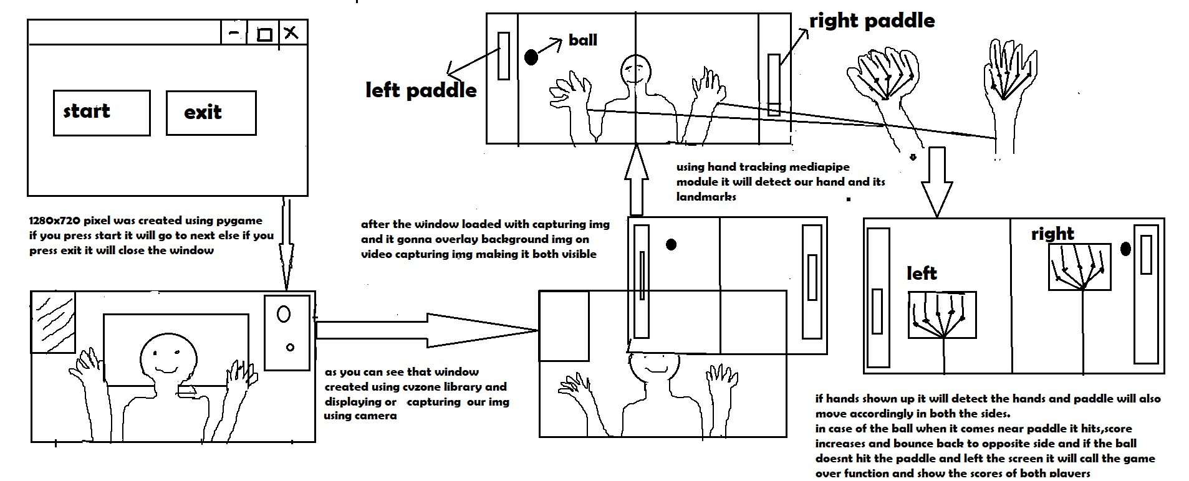
ARCHITECHTURE DIAGRAM

Slide 14
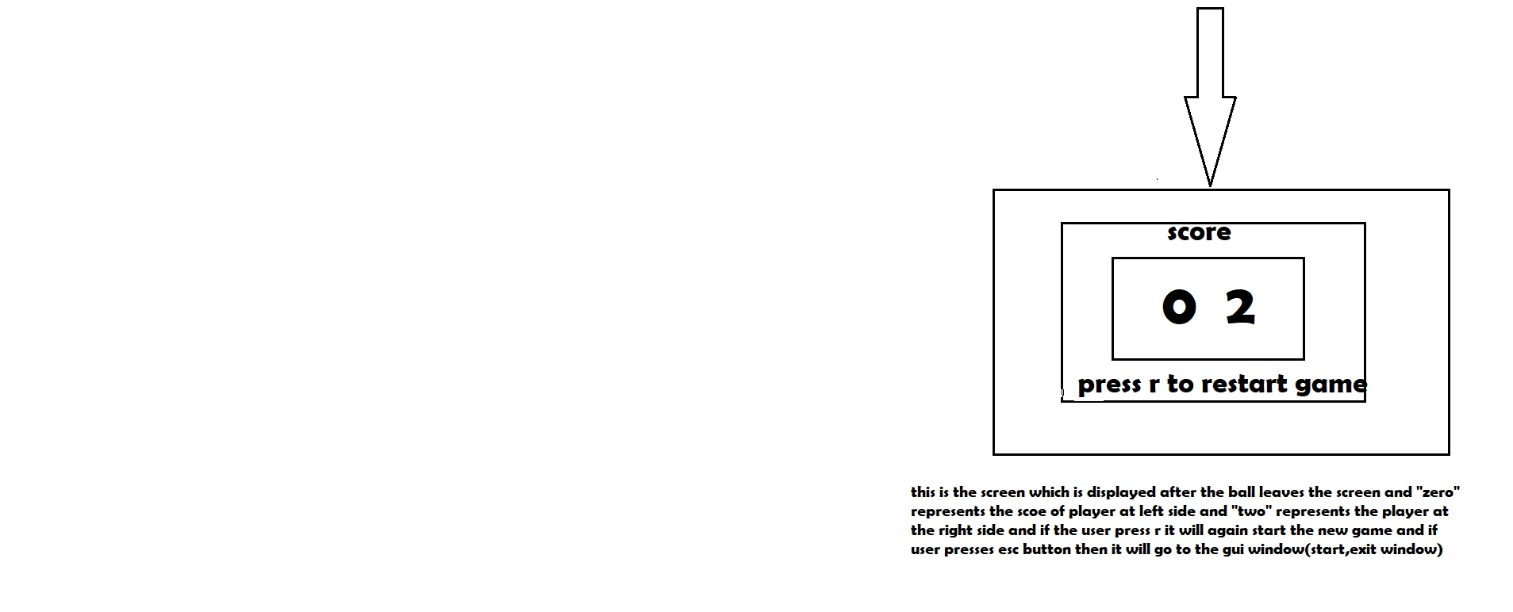

Slide 15
SYSTEM REQUIREMENTS
1.OPERATING SYSTEMS:
Windows
Mac
2.SOFTWARE
Python
3.HARDWARE:
USB webcam

Slide 16
References
References:
"Real-time hand gesture recognition using a depth sensor" by Mohamed E. K. Soliman and Mohamed S. Kamel, published in the Journal of Ambient Intelligence and Humanized Computing in 2021.
"A review of hand gesture recognition techniques for human-computer interaction" by Xiaofei Du, Xinghao Chen, and Yulong Dong, published in the Journal of Visual Communication and Image Representation in 2021.
"Deep learning for hand gesture recognition: A survey" by Ahmed Elgammal and Rania Ibrahim, published in the IEEE Access journal in 2021.
"Hand gesture recognition using deep learning: A survey" by S. Suresh, A. K. Singh, and R. K. Singh, published in the Journal of Ambient Intelligence and Humanized Computing in 2022.
"Hand gesture recognition using convolutional neural networks" by Wei-Chih Hung, Yu-Ting Chen, and Jyh-Cheng Chen, published in the Journal of Ambient Intelligence and Humanized Computing in 2021.
"MediaPipe: A Framework for Perceptual Computing" by Google Research, 2021.
Reference books:
"Mastering OpenCV 4 with Python: A practical guide covering topics from image processing, augmented reality to deep learning with OpenCV 4 and Python 3" by Alberto Fernández Villán
"OpenCV with Python By Example" by Prateek Joshi
"Learning OpenCV 4 Computer Vision with Python 3" by Joseph Howse

Slide 17
THANK YOU

